Slide 1
Logistic Regression
Juan Pablo Lewinger
June 29, 2021

Slide 2
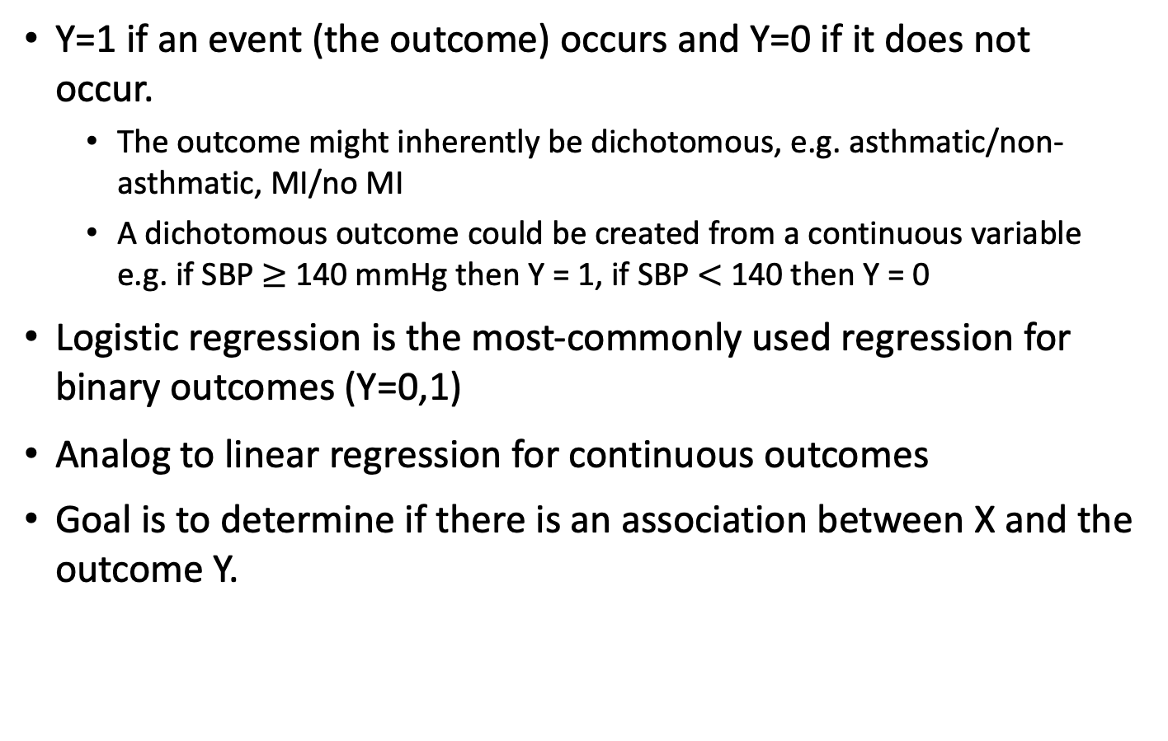
Binary Outcomes
Y=1 if an event (the outcome) occurs and Y=0 if it does not occur.
The outcome might inherently be dichotomous, e.g. asthmatic/non-asthmatic, MI/no MI
A dichotomous outcome could be created from a continuous variable e.g. if SBP $≥$140 mmHg then Y = 1, if SBP $<$140 then Y = 0
Logistic regression is the most-commonly used regression for binary outcomes (Y=0,1)
Analog to linear regression for continuous outcomes
Goal is to determine if there is an association between X and the outcome Y.

Slide 3
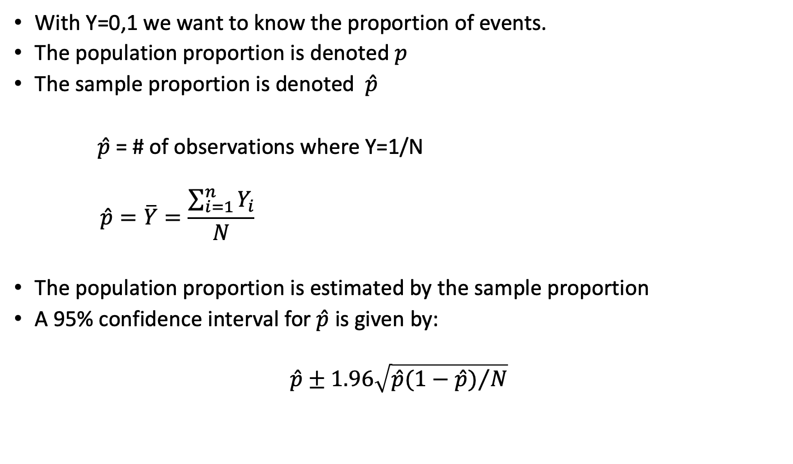
Binary Outcomes and Proportions
With Y=0,1 we want to know the proportion of events.
The population proportion is denoted $p$
The sample proportion is denoted $\hat{p}$
$\hat{p}$ = # of observations where Y=1/N
$$\hat{p}=\overline{Y}=\frac{\sum_{i=1}^{n}{Y_{i}}}{N}$$
The population proportion is estimated by the sample proportion
A 95% confidence interval for $\hat{p}$ is given by:
$$\hat{p}±1.96\sqrt{{\hat{p}(1−\hat{p})}/N}$$

Slide 4
Associations Between Binary Y and Binary X
Analogous to association between two continuous variables, we can look at associations between two categorical variables.
We use contingency tables to look at associations between binary a Y variable and categorical X variable.
When Y is binary and X is binary we have a 2x2 table
Tables summarize counts

Slide 5
Associations Between Binary Y and Binary X
2x2 table has the form:
An association between Y and X means the proportion/frequency of the event (Y=1) differs between those with X = 1 and X = 0
Variable X | Variable Y (outcome)
 |  | Y = 1 | Y = 0 | Totals
 | X = 1 | a | b | a + b
 | X = 0 | c | d | c + d
 | Totals | a + c | b + d | N

Slide 6
Associations Between Binary Y and Binary X
Example: CHS data
Frequency of asthma among Males = 99/517 = 0.19
Frequency of asthma among Females = 110/479 = 0.23
Is there an association between asthma and biological sex?
Sex | Asthma
 |  | No | Yes | Totals
 | Male | 418 | 99 | 517
 | Female | 369 | 110 | 479
 | Totals | 787 | 209 | 996

Slide 7
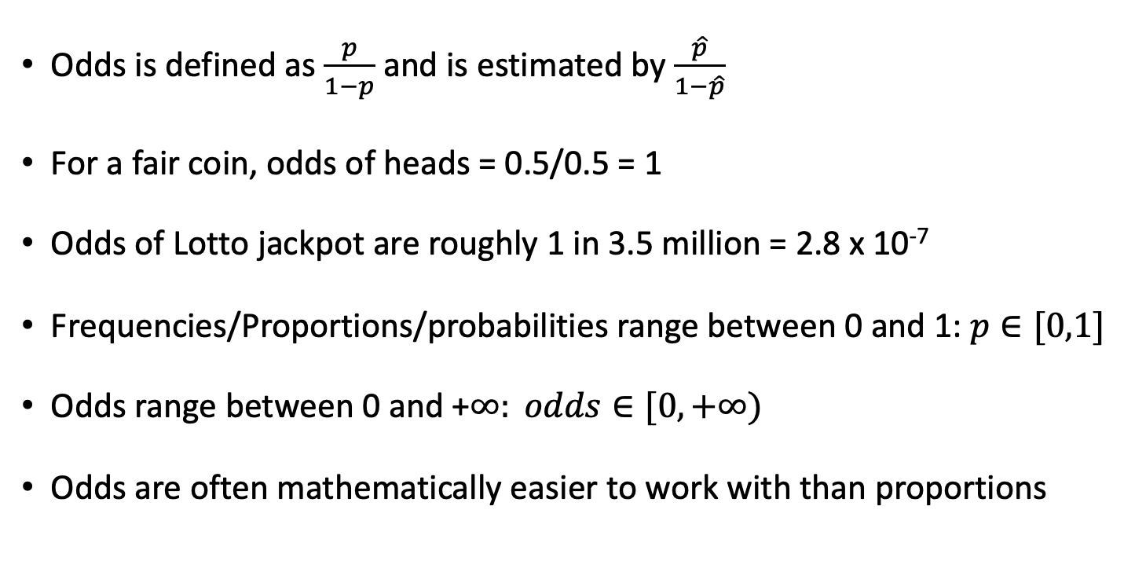
Odds
Odds is defined as $\frac{p}{1−p}$and is estimated by $\frac{\hat{p}}{1−\hat{p}}$
For a fair coin, odds of heads = 0.5/0.5 = 1
Odds of Lotto jackpot are roughly 1 in 3.5 million = 2.8 x 10⁻⁷
Frequencies/Proportions/probabilities range between 0 and 1: $p∈[0,1]$
Odds range between 0 and +$∞: odds∈[0,+∞)$
Odds are often mathematically easier to work with than proportions

Slide 8
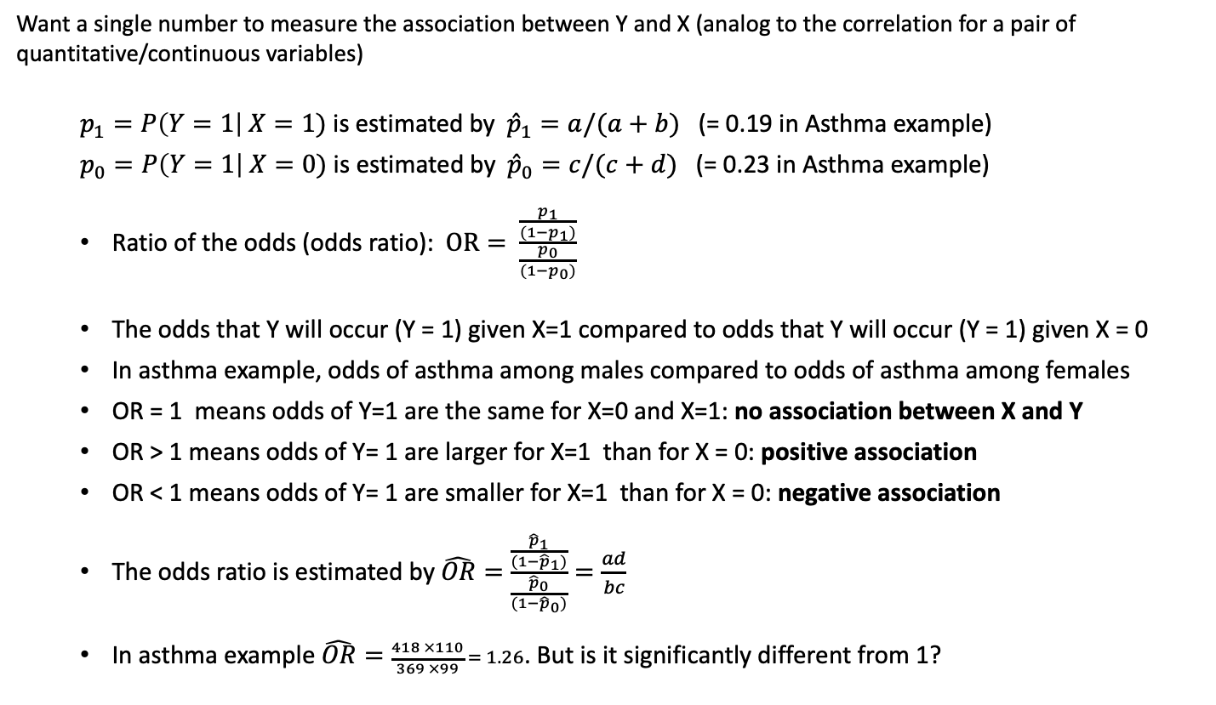
Odds Ratios
Want a single number to measure the association between Y and X (analog to the correlation for a pair of quantitative/continuous variables)
$p_{1}=P\left(Y=1\right| X=1)$ is estimated by ${\hat{p}}_{1}=a/(a+b)$ (= 0.19 in Asthma example)
$p_{0}=P\left(Y=1\right| X=0)$ is estimated by${\hat{p}}_{0}=c/(c+d)$ (= 0.23 in Asthma example)
Ratio of the odds (odds ratio): $OR= \frac{\frac{p_{1}}{(1−p_{1})}}{\frac{p_{0}}{(1−p_{0})}}$
The odds that Y will occur (Y = 1) given X=1 compared to odds that Y will occur (Y = 1) given X = 0
In asthma example, odds of asthma among males compared to odds of asthma among females
OR = 1 means odds of Y=1 are the same for X=0 and X=1: no association between X and Y
OR > 1 means odds of Y= 1 are larger for X=1 than for X = 0: positive association
OR < 1 means odds of Y= 1 are smaller for X=1 than for X = 0: negative association
The odds ratio is estimated by $\hat{OR}=\frac{\frac{{\hat{p}}_{1}}{(1−{\hat{p}}_{1})}}{\frac{{\hat{p}}_{0}}{(1−{\hat{p}}_{0})}}=\frac{ad}{bc}$
In asthma example $\hat{OR}=\frac{418 ×110}{369 ×99} = 1.26$. But is it significantly different from 1?

Slide 9
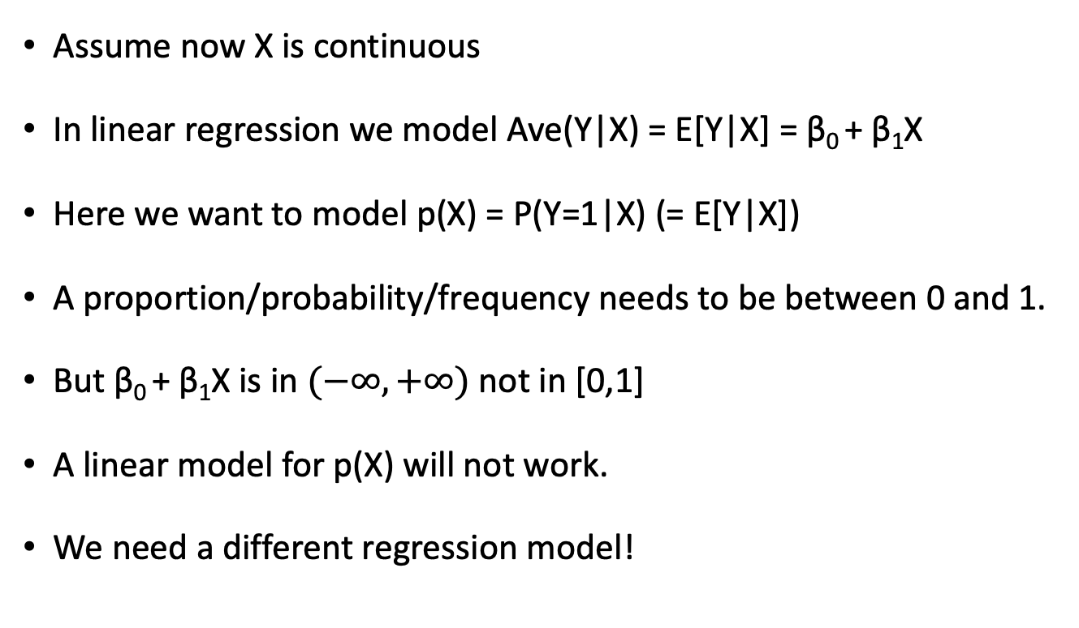
Logistic Regression
Assume now X is continuous
In linear regression we model Ave(Y|X) = E[Y|X] = β₀ + β₁X
Here we want to model p(X) = P(Y=1|X) (= E[Y|X])
A proportion/probability/frequency needs to be between 0 and 1.
But β₀ + β₁X is in $(−∞,+∞)$ not in [0,1]
A linear model for p(X) will not work.
We need a different regression model!

Slide 10
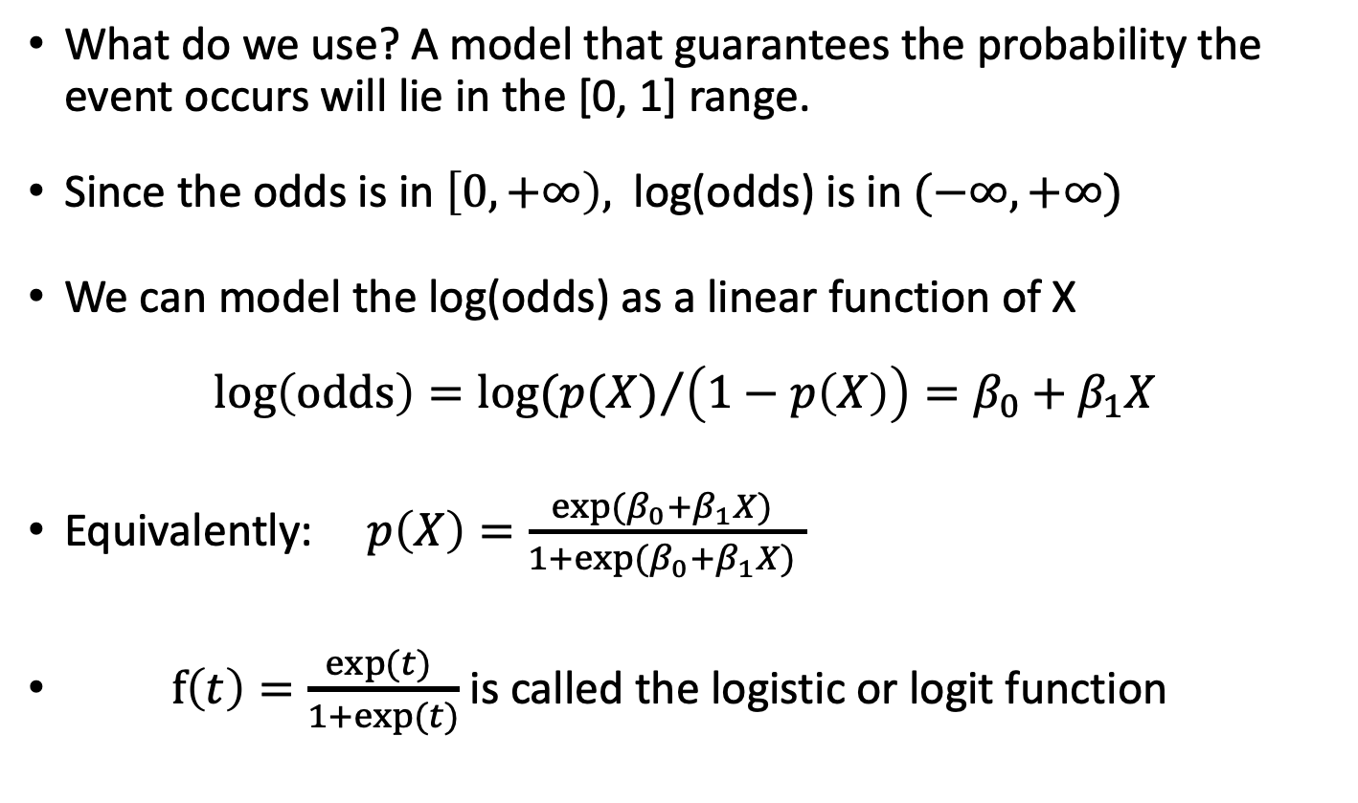
Logistic Regression
What do we use? A model that guarantees the probability the event occurs will lie in the [0, 1] range.
Since the odds is in $\left[0,+∞\right),$ log(odds) is in $(−∞,+∞)$
We can model the log(odds) as a linear function of X
$$log\left(odds\right)=log⁡({p(X)}/{\left(1−p\left(X\right)\right)=β_{0}+β_{1}X}$$
Equivalently: $p\left(X\right)=\frac{{exp⁡(β}_{0}+β_{1}X) }{{1+exp⁡(β}_{0}+β_{1}X) }$
$f\left(t\right)=\frac{exp⁡(t) }{1+exp⁡(t)}$ is called the logistic or logit function

Slide 11
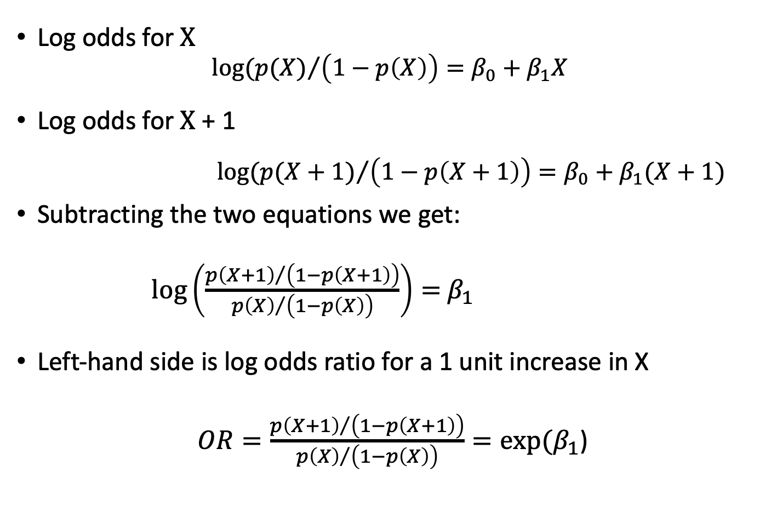

Interpretation of $β_{1}$
Log odds for X
$$log⁡({p(X)}/{\left(1−p\left(X\right)\right)=β_{0}+β_{1}X}$$
Log odds for X + 1
$$log⁡({p(X+1)}/{\left(1−p\left(X+1\right)\right)=β_{0}+β_{1}(X+1)}$$
Subtracting the two equations we get:
$\log\left(\frac{{p\left(X+1\right)}/{\left(1−p\left(X+1\right)\right)}}{{p\left(X\right)}/{\left(1−p\left(X\right)\right)}}\right)=$ $β_{1}$
Left-hand side is log odds ratio for a 1 unit increase in X
$OR=\frac{{p\left(X+1\right)}/{\left(1−p\left(X+1\right)\right)}}{{p\left(X\right)}/{\left(1−p\left(X\right)\right)}}=exp⁡(β_{1}$)

Slide 12
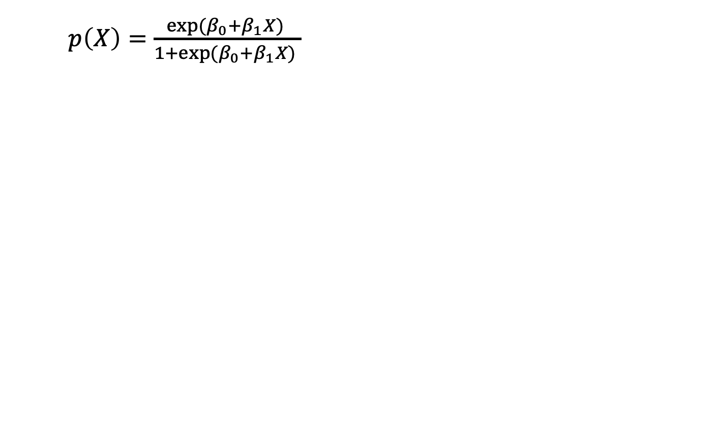
Logit function
$p\left(X\right)=\frac{{exp⁡(β}_{0}+β_{1}X) }{{1+exp⁡(β}_{0}+β_{1}X) }$

Slide 13
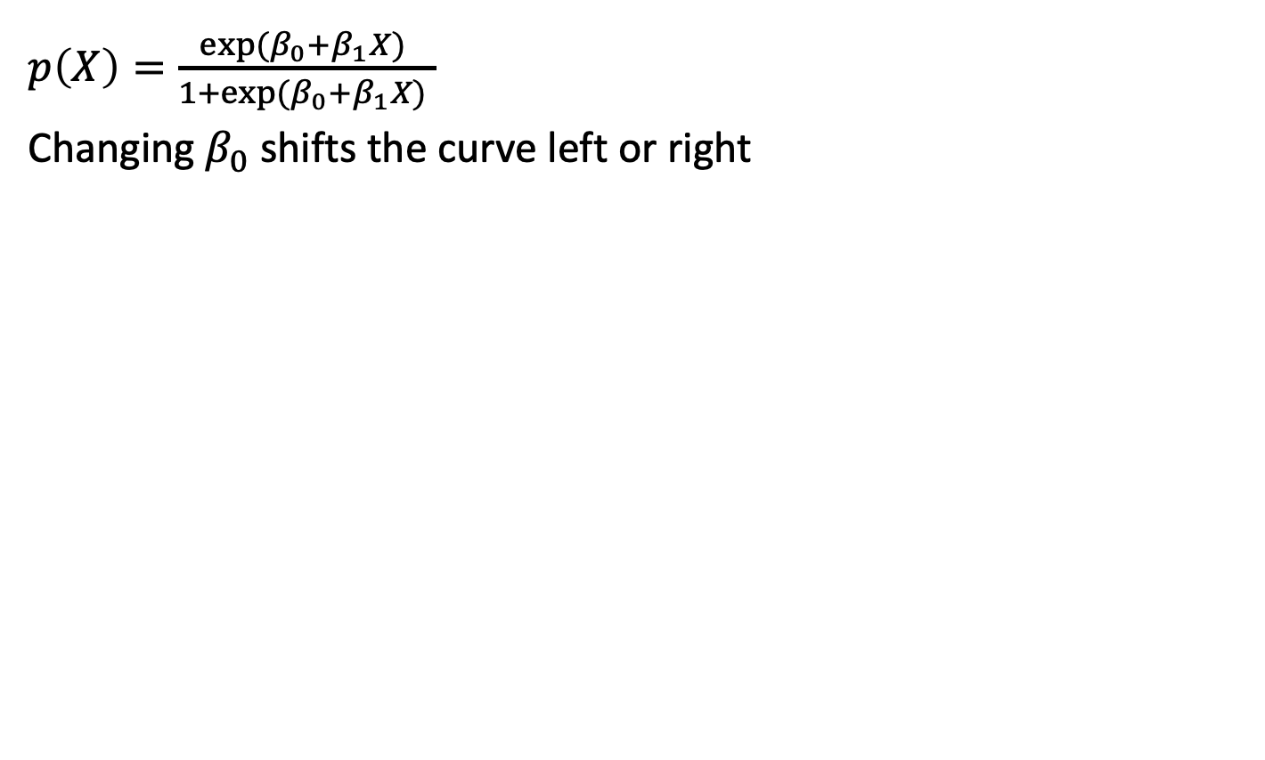
Logit function
$p\left(X\right)=\frac{{exp⁡(β}_{0}+β_{1}X) }{{1+exp⁡(β}_{0}+β_{1}X) }$
Changing $β_{0}$ shifts the curve left or right

Slide 14
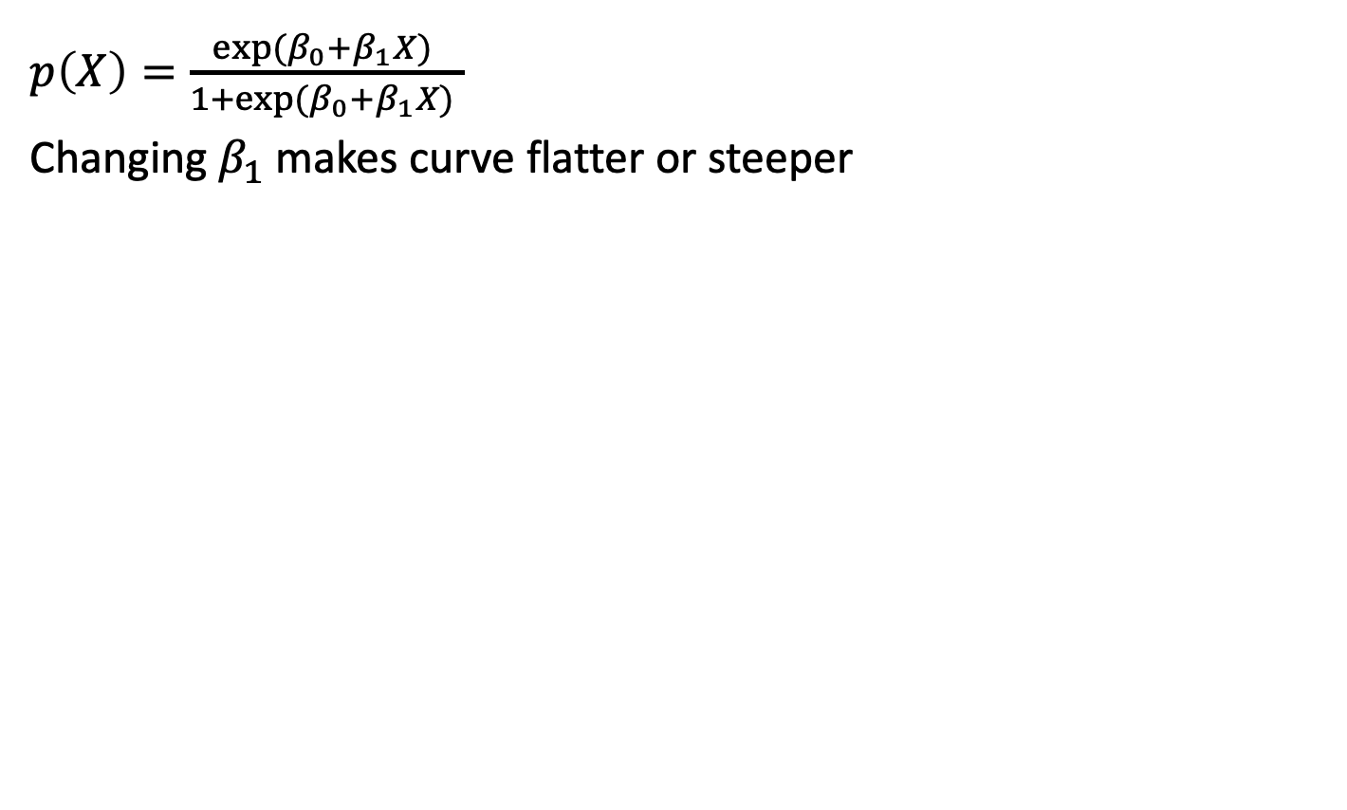
Logit function
$p\left(X\right)=\frac{{exp⁡(β}_{0}+β_{1}X) }{{1+exp⁡(β}_{0}+β_{1}X) }$
Changing $β_{1}$ makes curve flatter or steeper

Slide 15
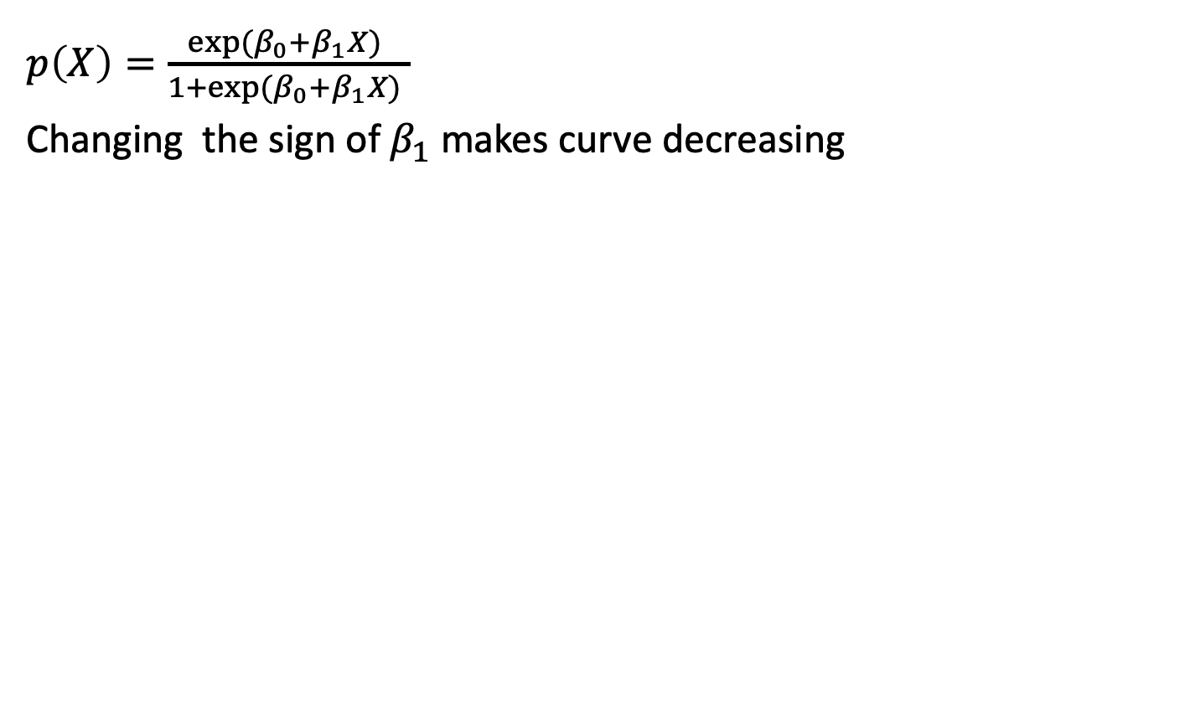
Logit function
$p\left(X\right)=\frac{{exp⁡(β}_{0}+β_{1}X) }{{1+exp⁡(β}_{0}+β_{1}X) }$
Changing the sign of $β_{1}$ makes curve decreasing

Slide 16
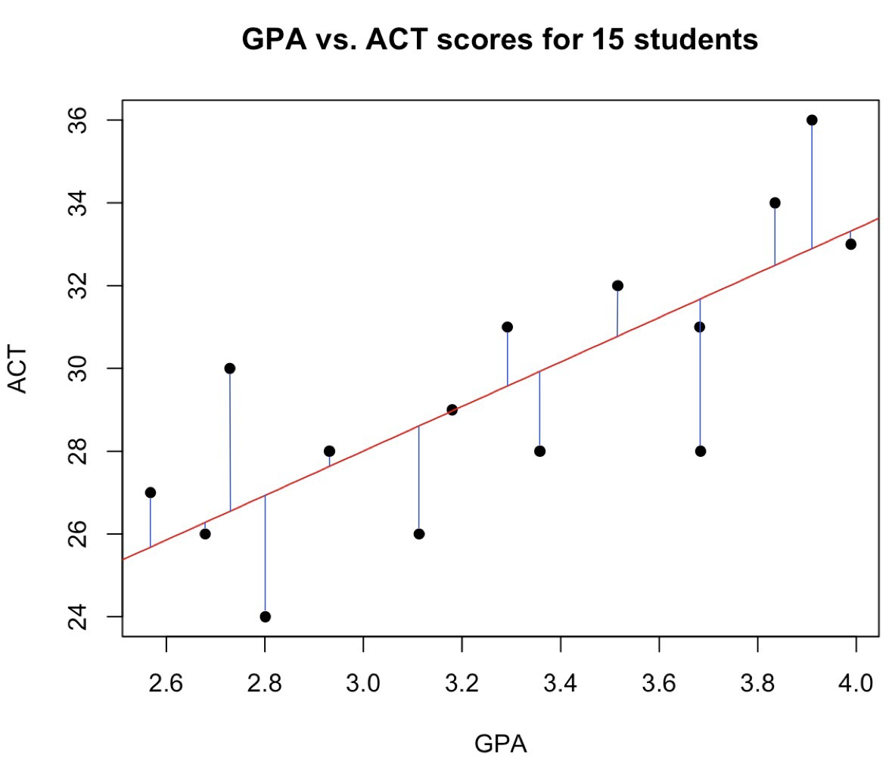
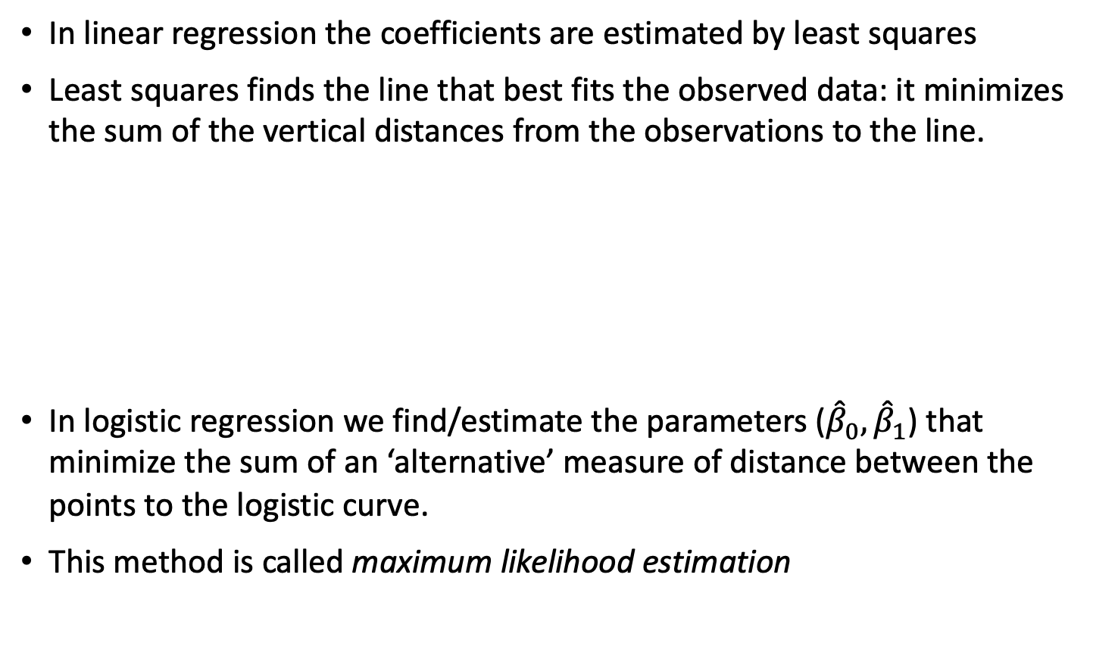
Logit function
In linear regression the coefficients are estimated by least squares
Least squares finds the line that best fits the observed data: it minimizes the sum of the vertical distances from the observations to the line.
In logistic regression we find/estimate the parameters (${\hat{β}}_{0},{\hat{β}}_{1}$) that minimize the sum of an ‘alternative’ measure of distance between the points to the logistic curve.
This method is called maximum likelihood estimation

Slide 17
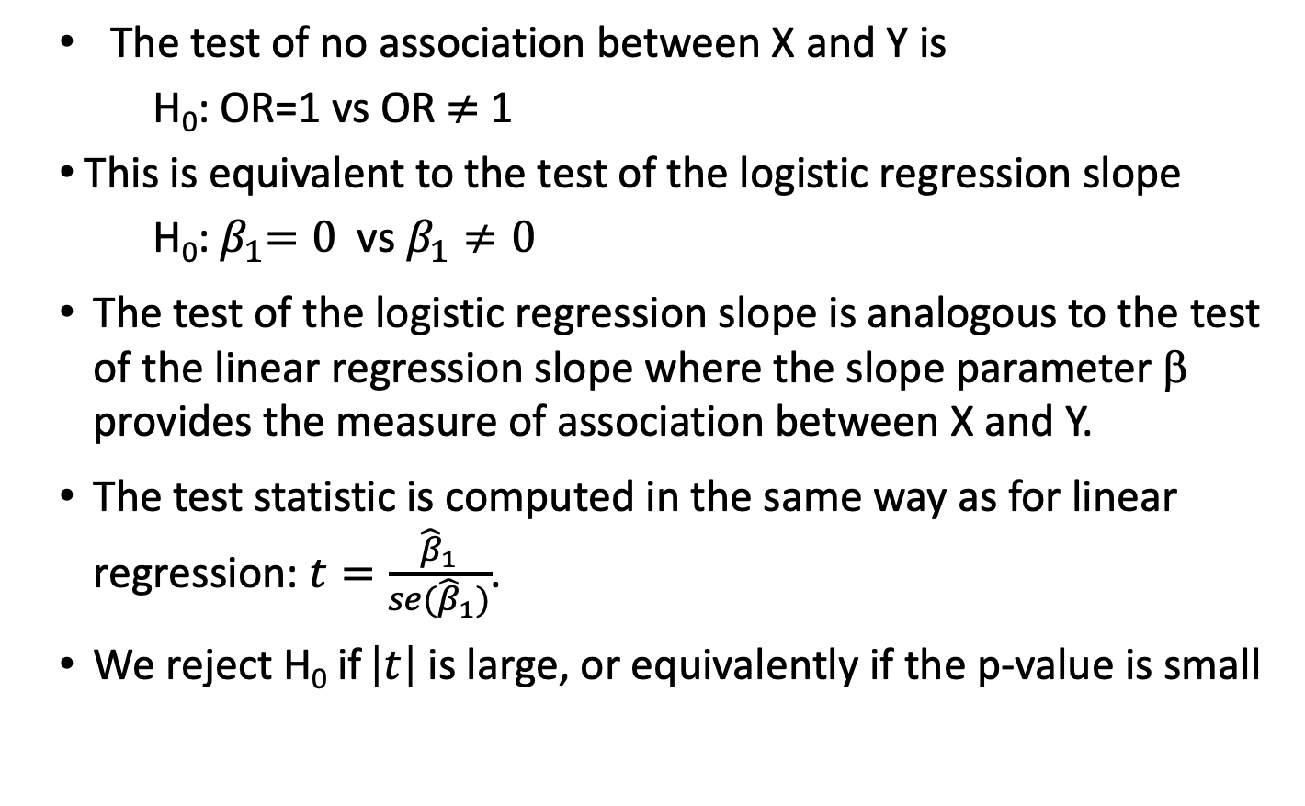
Hypothesis testing
The test of no association between X and Y is
H₀: OR=1 vs OR $≠$1
This is equivalent to the test of the logistic regression slope
H₀:${ β}_{1}=0$vs $β_{1}≠0$
The test of the logistic regression slope is analogous to the test of the linear regression slope where the slope parameter β provides the measure of association between X and Y.
The test statistic is computed in the same way as for linear regression: $t=\frac{{\hat{β}}_{1}}{se({\hat{β}}_{1})}$.
We reject H₀ if $\left|t\right|$ is large, or equivalently if the p-value is small

Slide 18
Logistic Regression in R
Logistic regression (logit model) in R can be fit using the glm() function for generalized linear model
For example, to look at the association between binary Y (asthma) and continuous X (age)
lr_age <- glm(asthma ~ age, family = "binomial”, data=chs)
summary(lr_age)
Coefficients:
Estimate Std. Error z value Pr(>|z|)
(Intercept) 0.7521 1.9465 0.386 0.699
age -0.1364 0.1278 -1.067 0.286

Slide 19
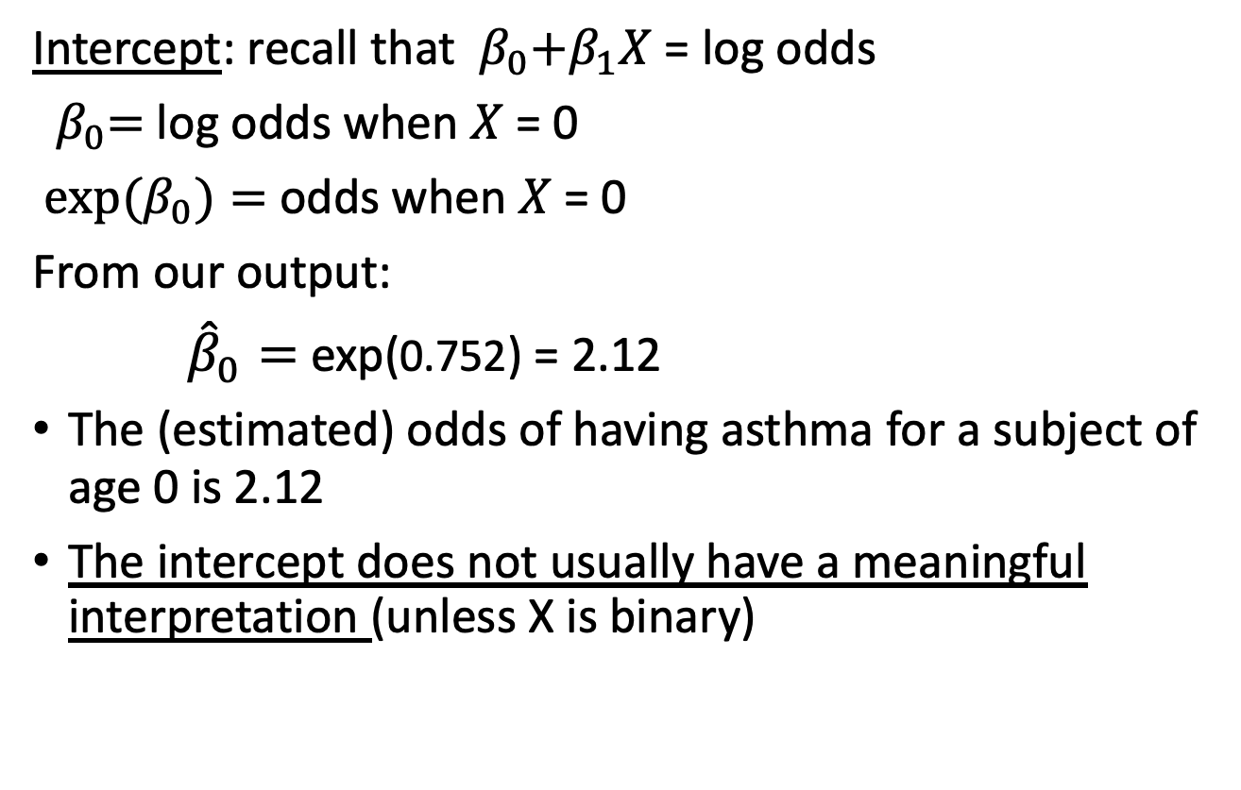
Logistic Regression Interpretation
Intercept: recall that ${{ β}_{0}+β}_{1}X$= log odds
${ β}_{0}=$log odds when $X$= 0
${ exp⁡(β}_{0})=$ odds when $X$= 0
From our output:
${\hat{β}}_{0}=$exp(0.752) = 2.12
The (estimated) odds of having asthma for a subject of age 0 is 2.12
The intercept does not usually have a meaningful interpretation (unless X is binary)

Slide 20
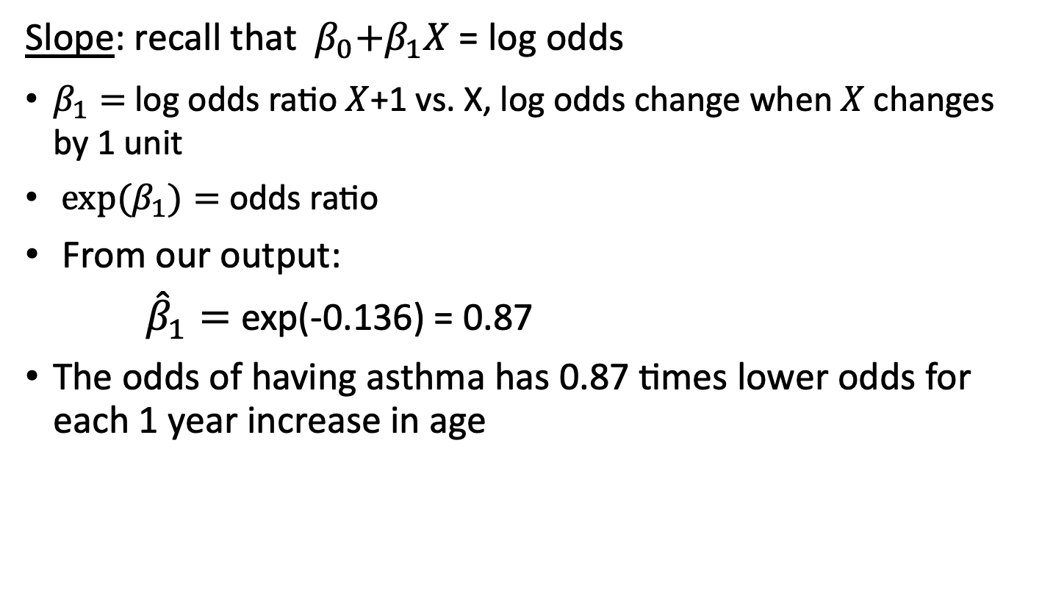
Logistic Regression Interpretation
Slope: recall that ${{ β}_{0}+β}_{1}X$= log odds
$β_{1}=$log odds ratio $X$+1 vs. X, log odds change when $X$changes by 1 unit
${ exp⁡(β}_{1})=$ odds ratio
From our output:
${\hat{β}}_{1}=$exp(-0.136) = 0.87
The odds of having asthma has 0.87 times lower odds for each 1 year increase in age

Slide 21
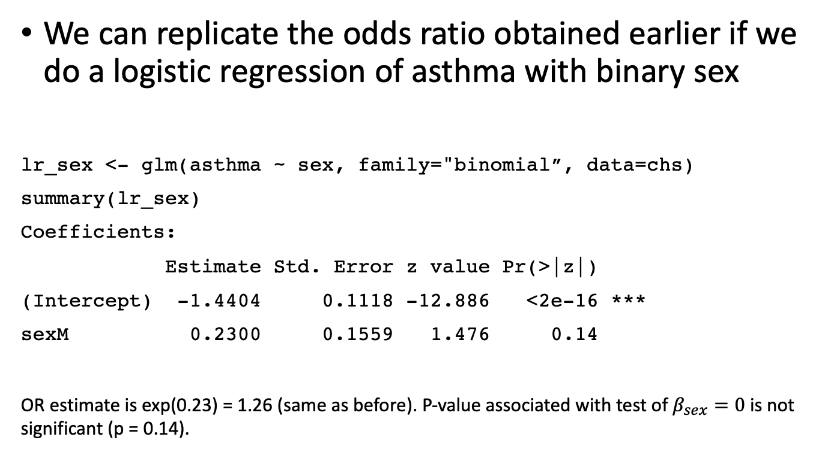
Logistic Regression with Binary X
We can replicate the odds ratio obtained earlier if we do a logistic regression of asthma with binary sex
lr_sex <- glm(asthma ~ sex, family="binomial”, data=chs)
summary(lr_sex)
Coefficients:
Estimate Std. Error z value Pr(>|z|)
(Intercept) -1.4404 0.1118 -12.886 <2e-16 ***
sexM 0.2300 0.1559 1.476 0.14
OR estimate is exp(0.23) = 1.26 (same as before). P-value associated with test of $β_{sex}=0$is not significant (p = 0.14).

Slide 22
Logistic regression with multiple variables
For multiple logistic regression we have:
logit(p) = β₀ + β₁ X₁ + β₂ X₂ + … β_{p} X_{p}
The interpretation of β₁ is the log-odds ratio for Y associated with a change of one unit in X₁ while keeping all other variables fixed.

Slide 23
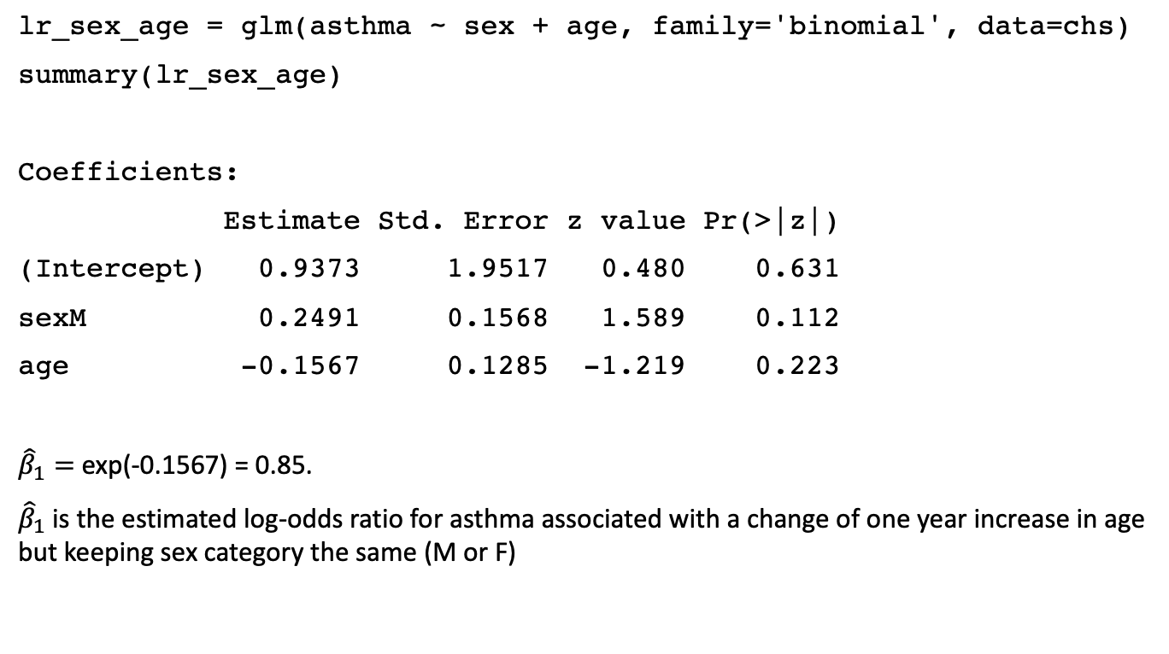
Logistic regression with multiple variables
lr_sex_age = glm(asthma ~ sex + age, family='binomial', data=chs)
summary(lr_sex_age)
Coefficients:
Estimate Std. Error z value Pr(>|z|)
(Intercept) 0.9373 1.9517 0.480 0.631
sexM 0.2491 0.1568 1.589 0.112
age -0.1567 0.1285 -1.219 0.223
${\hat{β}}_{1}=$exp(-0.1567) = 0.85.
${\hat{β}}_{1}$is the estimated log-odds ratio for asthma associated with a change of one year increase in age but keeping sex category the same (M or F)

